Slide 1
Clinical Supervision Foundations
Thomas M. Litwicki, M.Ed., LISAC

Slide 2

Our Journey

Slide 3
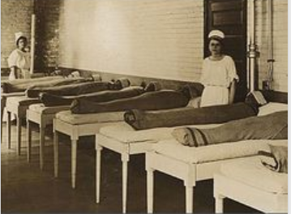
Supervisor Foundations
FA1: Theories, Roles, and Modalities of Clinical Supervision;

Slide 4

FA2: Leadership

Slide 5

FA3: Supervisory Alliance;

Slide 6

FA4: Critical Thinking

Slide 7

FA5: Organizational Management and Administration.

Slide 8
Performance Dimensions
PD1: Counselor Development;

Slide 9
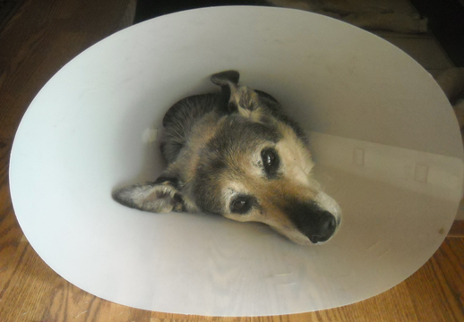
PD2: Professional and Ethical Standards;

Slide 10

PD3: Program Development and Quality Assurance;

Slide 11

PD4: Performance Evaluation

Slide 12
PD5: Administration.

